Slide 1
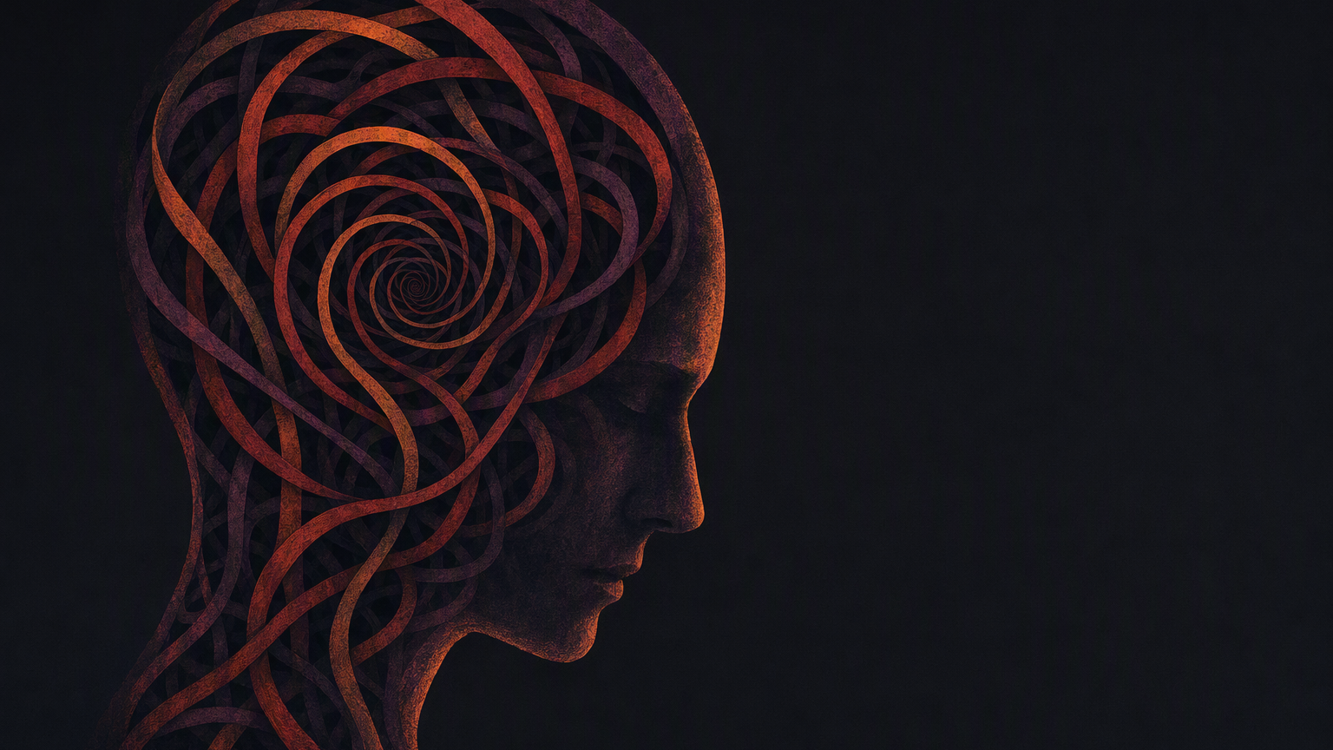
THE RESONANT IDENTITY
The Judgment Loop
How Distortion Compounds and Erodes Identity
Episode 18 · The Resonant Identity · TheResonantIdentity.com

Slide 2
THE JUDGMENT LOOP
Three mechanisms turn a single trigger into a story about who you are
Judgment
Narrative
Identity Distortion
A single-event read of what happened. Right or wrong, it isn't yet who you are.
Repeated judgments become the story we tell about ourselves, in the language of always and never.
Once the story feels proven, we align with it as truth and start deciding from the lie.
All three loops start from the same neutral trigger. What differs is what happens next.
Source: Chapter 12, The Resonance Core Framework

Slide 3
One trigger, six steps: how reactivity compounds into Identity Collapse
01
TRIGGER
02
REACTIVITY
03
DISSONANCE
04
BIAS
05
ALIGNMENT
06
COLLAPSE
REPEATS — UNLESS THE CHAIN IS BROKEN
Unless the chain is broken, the loop closes on itself and runs again with the next trigger.
Source: Chapter 12, The Resonance Core Framework

Slide 4
Trigger, reactivity, and dissonance set the Judgment Loop in motion
01 · TRIGGER
02 · REACTIVITY & CHOICE
03 · DISSONANCE
A Data Point that feels uncomfortable or misaligned: feedback, a mistake, an uninvited thought.
The nervous system reads discomfort as danger. We choose: accept truth, suppress it, or dig in.
Holding two beliefs at once is uncomfortable, until the feeling itself gets mistaken for proof.
Emotional Intelligence and Embodied Awareness decide which path comes next.
“The Truth isn't rejected because of logic. It's rejected because the body reacted, and the feeling proves it isn't correct.”
Source: Chapter 12, The Resonance Core Framework

Slide 5
Bias and distortion compound until the loop
closes into Identity Collapse
04 · CONFIRMATION BIAS
BIAS
The brain surfaces old memories and isolated examples that confirm the story, filtering out anything that would challenge it.
ALIGNMENT
COLLAPSE
05 · DISTORTED ALIGNMENT
The dissonance fades. Not because the person found Truth, but because they've accepted Distortion as identity.
Each repeat compounds the last: the loop feeds itself.
06 · IDENTITY COLLAPSE
Distortion compounds with every repeat, eroding the sense of Self into shame, doubt, and mistrust.

Slide 6
THE JUDGMENT LOOP · CLOSING
“Not a dramatic fracture, but a slow erosion: loop by loop, judgment by judgment.”
— Episode 18, The Resonant Identity
See how to break the chain. Explore The Data Loop next.
THERESONANTIDENTITY.COM

